Slide 1

Blazor
Web, Desktop and Mobile Applications
SoftUni Team
Technical Trainers
Software University
https://softuni.bg

Slide 2
Table of Contents
What is Blazor?
Blazor on WebAssembly
Blazor on the Server
Blazor in Depth
Components, Routing, DI, Lifecycle
Data Binding, Validation, Events, JS Interop
Blazor as Desktop Application
Mobile Blazor Bindings (Experimental)

Slide 3
Have a Question?
sli.do #csharp-web

Slide 4

Blazor
Interactive client-side web UI with .NET

Slide 5
What is Blazor?
Framework for building interactive client-side web UI with .NET
Uses C# (instead of JS), Razor and HTML/CSS
Share application logic across server and client
No plugins needed (its not another Flash/Silverlight)
Component-based single-page application (SPA) framework
Blazor supports 2 hosting models
Run client-side C# code in the browser, using WebAssembly
Run client logic on the server, transfer using SignalR
Open source with free tools

Slide 6
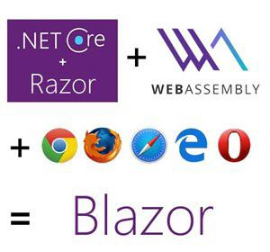
Blazor Features
A component model for building composable UI
Layouts, pages and components (using Razor)
Built-in routing (same ASP.NET Core routing rules)
Two-way data-binding
Support for forms and validation (data annotations)
Easy dependency injection (similar to ASP.NET Core)
Two-way JavaScript interop
Rich IntelliSense and tooling (Visual Studio 2019)
Full debugging both in browsers and in the IDE
Separated UI changes (component model) and how those changes are applied (renderer)

Slide 7
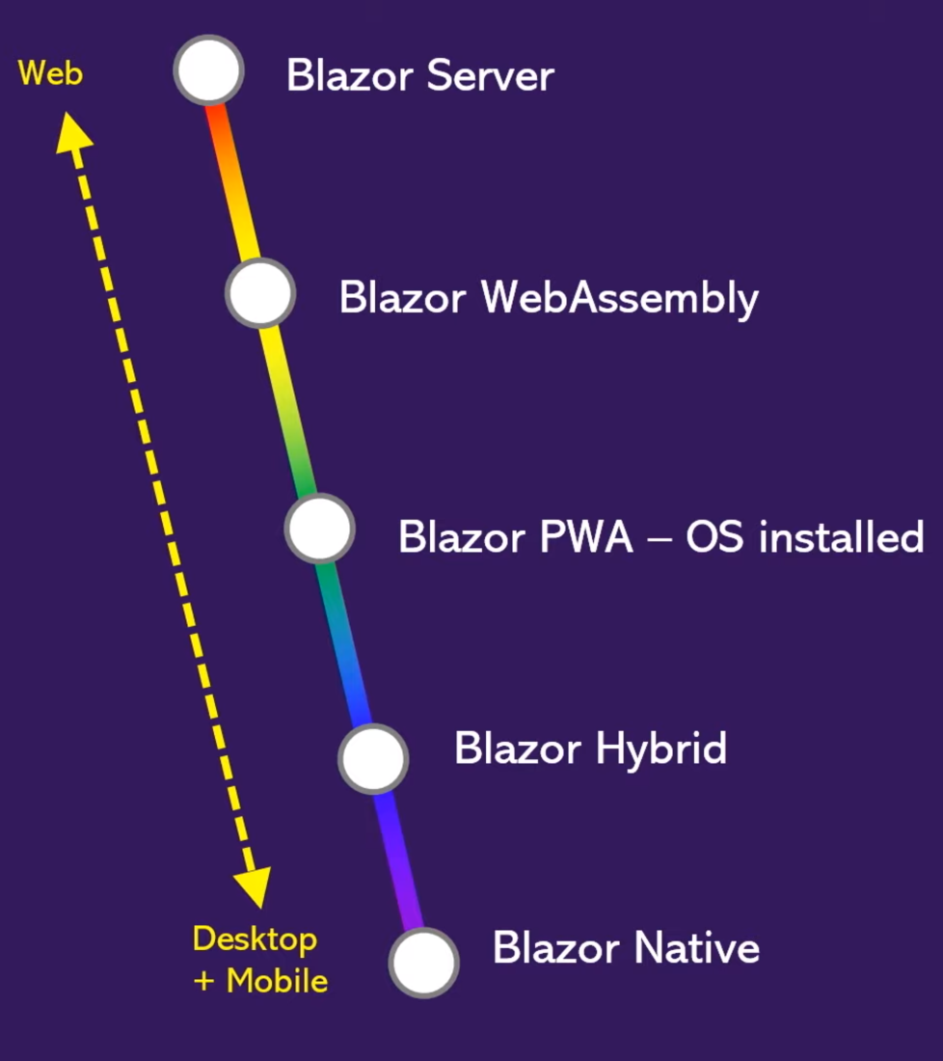
Blazor Renderers
Web (desktop and mobile browsers)
Blazor Server (remote renderer) – Supported
Blazor WebAssembly – Committed product
Desktop (Windows, Mac, and Linux)
Progressive Web Application (PWA)
Blazor Electron – Experimental
WebWindow – Experimental
.NET 6 Preview Introduces Blazor Desktop
Mobile Native (iOS and Android)
Mobile Blazor Bindings (Xamarin) – Experimental

Slide 8
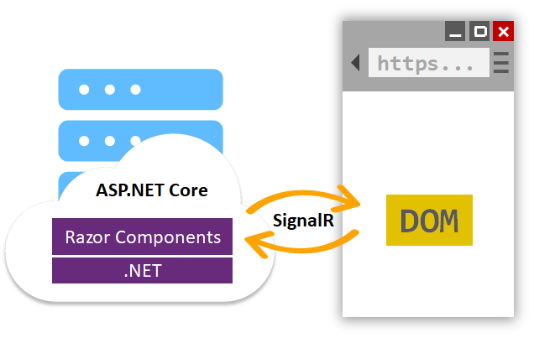
Blazor on the Server
The application is executed on the server from within an ASP.NET Core app
UI updates, event handling, and JavaScript calls are handled over a SignalR connection
Every user interaction involves a network hop
If the client connection fails, the app stops working

Slide 9
What is WebAssembly?
Binary instruction format for a stack-based virtual machine
Similar to traditional assembly languages with small instruction set
W3C Standard - https://webassembly.org/
Lower level than JavaScript (thus faster)
JavaScript Interop
Work along with JavaScript in two-way integration
Supported by all major browsers
https://caniuse.com/#feat=wasm
Polyfill: asm.js can execute .wasm files in JavaScript

Slide 10
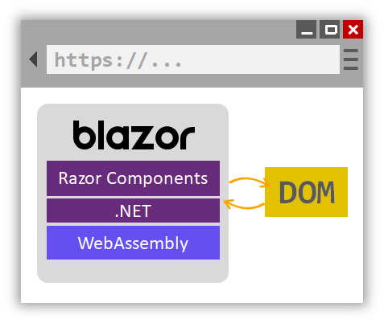
Blazor on WebAssembly
The .NET runtime is the VM that runs C# code for Blazor
.NET runtime is compiled to WebAssembly
dotnet.wasm file
The actual .dll files are downloaded as-is and ran by the .NET runtime
Blazor uses IL Linker to reduce the app size

Slide 11
Client-side vs Server-side Blazor
Client-side apps don't have .NET server-side dependency
Client capabilities and resources are fully leveraged
Work is offloaded from the server to the client
Serverless deployment is possible (CDN)
Server-side apps code is not visible to the clients
Work with browsers that don't support WebAssembly
Download size is significantly smaller, latency – higher
Use of server resources and .NET Core compatible APIs

Slide 12

Blazor in Depth
Components, Routing, DI, Data binding, Validation, Events, JS interop

Slide 13
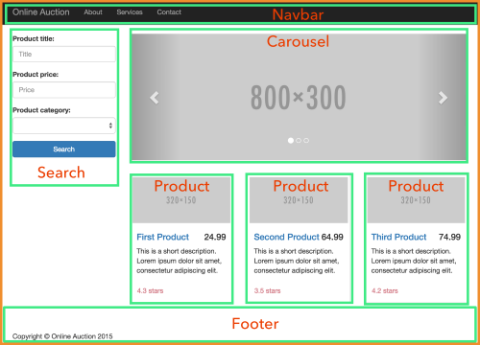
Components
In Blazor everything in the UI is a component (like Angular)
Used to represent a single text field as well as a whole page
Component can contain any number of other components
Components are compiled to .NET classes
Components can have parameters
The base component is App.razor
App.razor declares the MainLayout

Slide 14
Components Example
@page "/ParentComponent"
<h1>Parent-child example</h1>
<ChildComponent Title="Panel title from parent">
Child content of the child component is supplied by the parent.
</ChildComponents>
ParentComponent.razor
<div class="panel panel-success">
<div class="panel-heading">@Title</div>
<div class="panel-body">@ChildContent</div>
</div>
@code {
[Parameter] private string Title { get; set; }
[Parameter]
private RenderFragment ChildContent { get; set; }
}
ChildComponent.razor

Slide 15
Routing
.razor files with @page directive are considered pages
Route template can be specified
Route parameters can be used as component parameters
Route constraints can be applied
NavigationManager works with URIs and navigation
@page "/Songs"
@page "/Songs/{id:int}"
@code {
[Parameter]
public int Id { get; set; }
}

Slide 16

Dependency Injection
Blazor supports dependency injection (DI)
Registration is done in the Main() method
In the Client web application's Configuration
Services can be Singleton and Transient
Default services: IJSRuntime and NavigationManager
HttpClient can be injected with BaseAddress set-up
Using in components:
builder.Services.AddSingleton<IApplicationState, ApplicationState>();
@inject IApplicationState ApplicationState

Slide 17
Components Lifecycle
Instantiate and resolve services
OnInitialized()
OnInitializedAsync()
@implements IDisposable
IDisposable.Dispose()
SetParametersAsync()
OnParametersSet()
OnParametersSetAsync()
Resolve parameters
Disposal
Resolve sub components
OnAfterRender()
OnAfterRenderAsync()
State has changed
Render component
ShouldRender()
this.StateHasChanged()

Slide 18
Data Binding in Blazor (1)
Interpolation – same as in Razor
Conditional content and lists
<!-- Simple interpolation. In Angular, this would be {{ Count }}
-->
<p>Counter: @Count</p>
<!-- Conditionally display content In Angular, this would be *ngIf
-->
@if (ShowWarning) {
<p style="background-color: red; padding: 5px">Warning!</p>
}
<!-- Bind to a collection In Angular, you would do that with *ngFor
-->
<ul>
@foreach (var number in Numbers)
{
<li>@number</li>
}
</ul>

Slide 19
Data Binding in Blazor (2)
Two-way binding
<!--
Angular two-way binding
<input [(ngModel)]="username">
-->
<input type="text" @bind="this.Name" />
<input @bind="CurrentValue" @bind:event="oninput" /> <!-- onchange -->
<input type="number" @bind="(this.Age)" />
<input type="text" @bind="(this.Birthday)" @bind:format="dd.MM.yyyy" />
<input type="checkbox" @bind="(this.IsAdmin)" />
<select id="select-box" @bind="(this.TypeOfEmployee)" />
<option value=@EmployeeType.Employee>@EmployeeType.Employee</option>
<option value=@EmployeeType.Intern>@EmployeeType.Intern</option>
</select>

Slide 20
Forms and Validation
Model file
Component code
using System.ComponentModel.DataAnnotations;
public class ExampleModel
{
[Required]
[StringLength(10, ErrorMessage = "Name is too long.")]
public string Name { get; set; }
}
<EditForm Model="exampleModel" OnValidSubmit="HandleValidSubmit">
<DataAnnotationsValidator />
<ValidationSummary />
<InputText id="name" @bind-Value="exampleModel.Name" />
<button type="submit">Submit</button>
</EditForm>

Slide 21
Events Handling
Supported events: @onclick, @onchange, @onkeypress...
And many more: EventHandlers.cs
<!-- Angular -->
<button (click)="method()">...</button>
<button @onclick="Clicked">Click me</button>
<button @onclick="@(() => Console.WriteLine("Hello World!"))">Click me</button>
<input type="text" @onchange=@(e => Console.WriteLine(e.Value)) />
@functions {
private void Clicked()
{
Console.WriteLine("Hello World!");
}
}

Slide 22
JavaScript Interop (1)
Blazor and WebAssembly can't directly access the Browser's DOM
The JavaScript interop provides a means of filling the gap
window.myNamespace = {
showPrompt: function (message) {
return prompt(message, 'Type anything here');
}
};
@inject IJSRuntime JsRuntime;
<button @onclick="Prompt">Click here to show a prompt</button>
@code {
async void Prompt() {
var text = await
JsRuntime.InvokeAsync<string>("myNamespace.showPrompt", "So?");
}
}

Slide 23
JavaScript Interop (2)
Invoke a static .NET method from JavaScript
All parameters should be serializable from JSON
Invoke a .NET instance method from JavaScript
Pass the .NET instance by reference to JavaScript
Invoke method on the instance using invokeMethod
[JSInvokable]
public static Task<int> SomeStaticDotNetMethod() { return Task.FromResult(2); }
// In JavaScript we can call it with:
DotNet.invokeMethodAsync('AssemblyName', 'SomeStaticDotNetMethod')
.then(data => { console.log(data); });

Slide 24
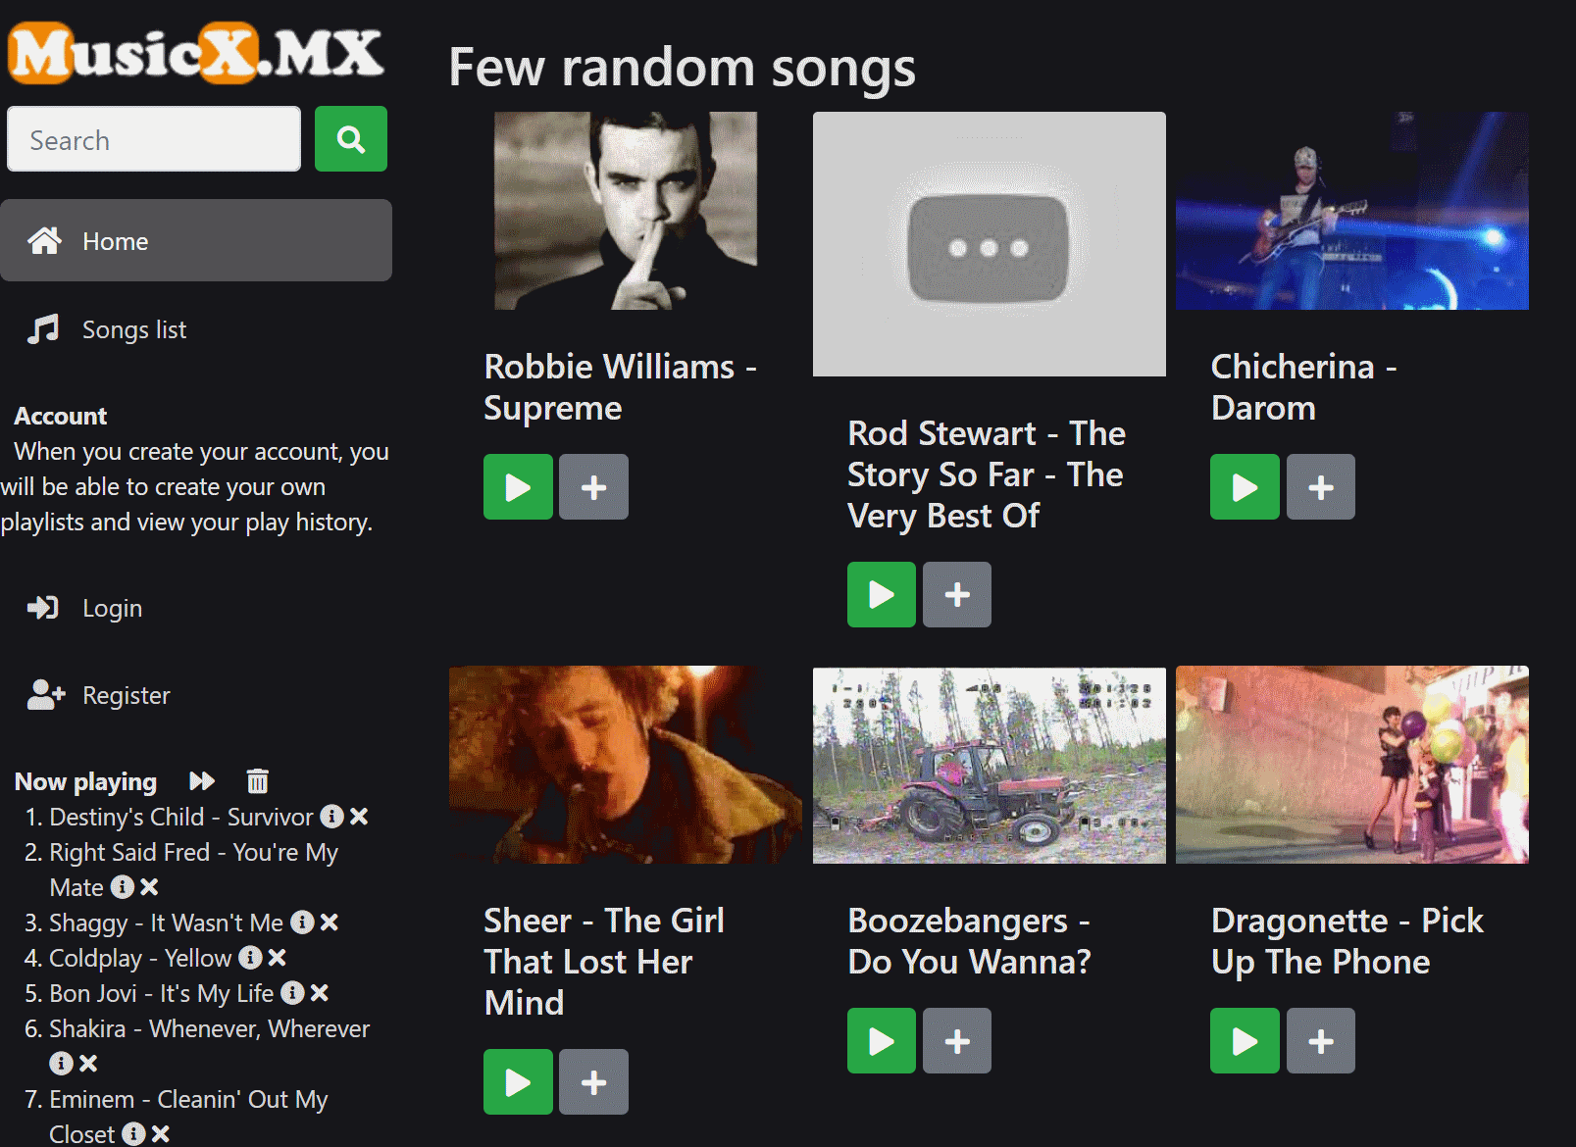
Live Demo
Simple web music player built with Blazor WebAssembly
https://github.com/NikolayIT/MusicX
https://musicx.mx
ASP.NET Core 5.0
Blazor WebAssembly

Slide 25
Blazor on the Desktop
Electron, WebWindow, PWA, Blazor Desktop in MAUI

Slide 26
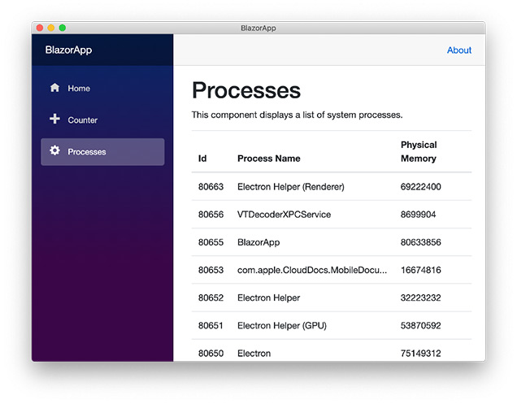
Electron
Desktop GUI applications using web technologies
Combines the Chromium rendering engine and Node.js runtime
Examples: VS Code, Postman, GitHub Desktop, etc.
Host Razor Components inside an Electron shell
Experimental and unsupported
Microsoft.AspNetCore.Components.Electron
Another option: Electron.NET
Alternatively: Daddoon/BlazorMobile
ComponentsElectron.Run<Startup>("wwwroot/index.html");

Slide 27
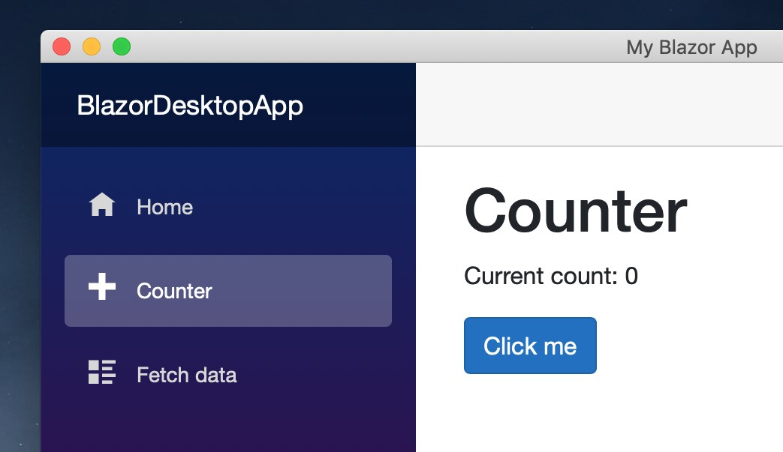
WebWindow
An experimental lightweight alternative to Electron
No need to bundle Node.js or Chromium
Electron requires 164MB of space and 30MB memory
Works on all operating systems
Windows – the new Chromium-based Edge via webview2
Mac – the OS’s built-in WKWebView
Linux – uses WebKitGTK+2
NuGet packages
WebWindow and WebWindow.Blazor

Slide 28
Progressive Web App
A web-based app that uses modern browser APIs and capabilities to behave like a native app
Working offline and always loading instantly
Being able to run in its own app window
Launched from the host OS start menu, dock, or home screen
Receiving push notifications from a backend server, even while the user is not using the app
Automatically updating in the background
User first opens the SPA then install it as PWA

Slide 29
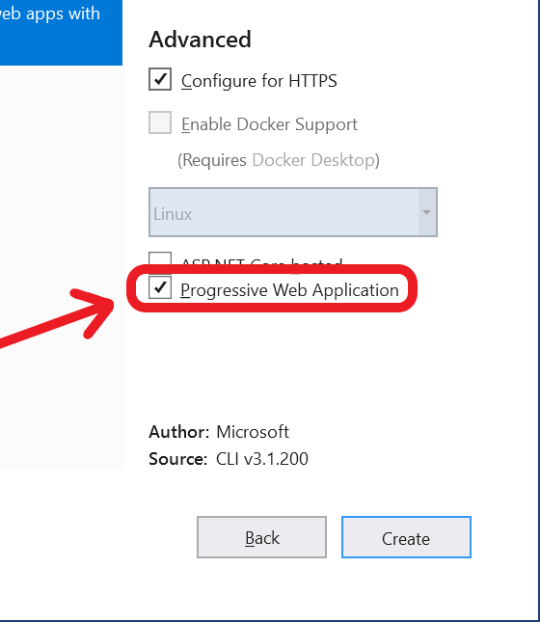
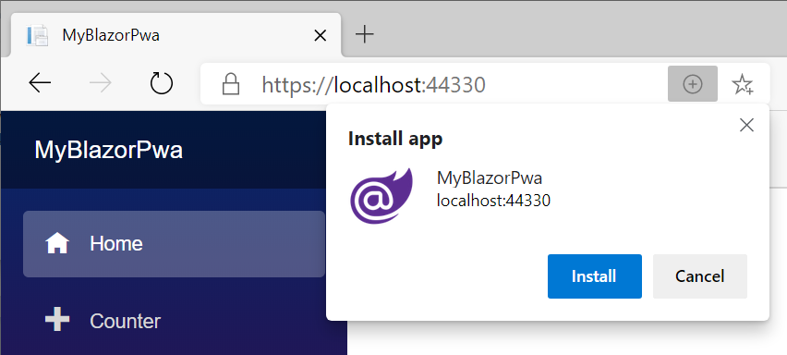
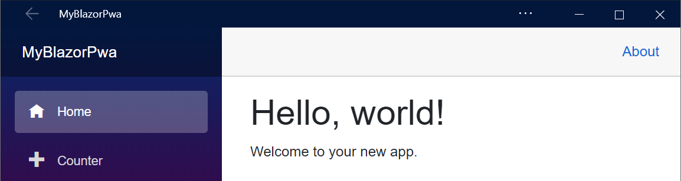
Blazor as PWA
Easy to enable PWA from the template settings in VS
manifest.json will be created and included in index.html

Slide 30
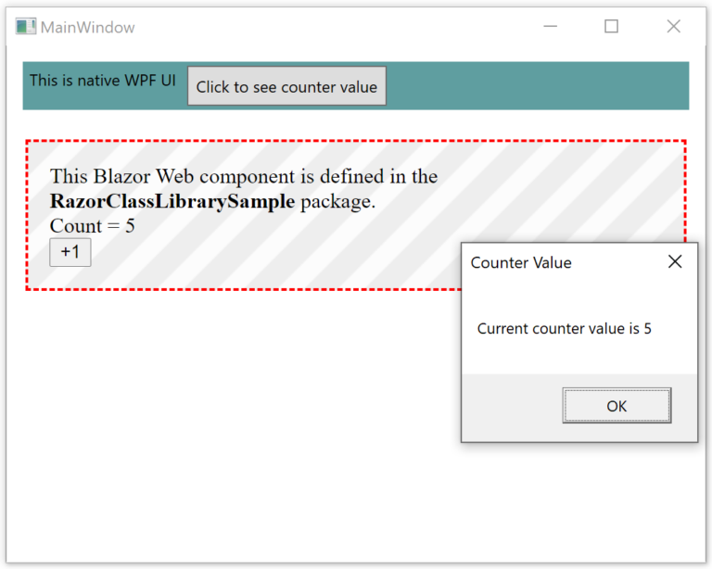
Blazor Desktop in MAUI
.NET 6 introduces MAUI
.NET Multi-platform App UI
Currently in preview
Blazor Desktop will be hosted via a MAUI WebView
Create hybrid client apps
combine web and native UI in a native client application

Slide 31
Mobile Blazor Bindings
Build native mobile apps for iOS and Android using Blazor

Slide 32
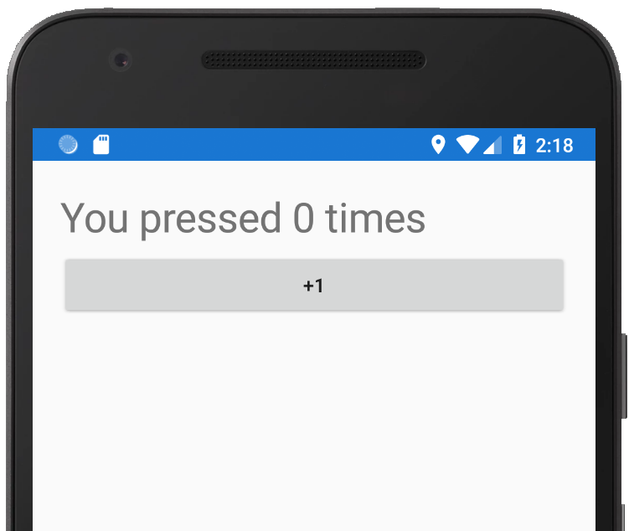
Mobile Blazor Bindings
Build native mobile apps for iOS and Android using Blazor
Uses Blazor programming model to define UI components
UI components based on Xamarin.Forms UI controls (no HTML)
<StackLayout>
<Label FontSize="30"
Text="@($"You pressed {count} times")" />
<Button Text="+1" OnClick="HandleClick" />
</StackLayout>
@code {
int count;
void HandleClick() { count++; }
}

Slide 33
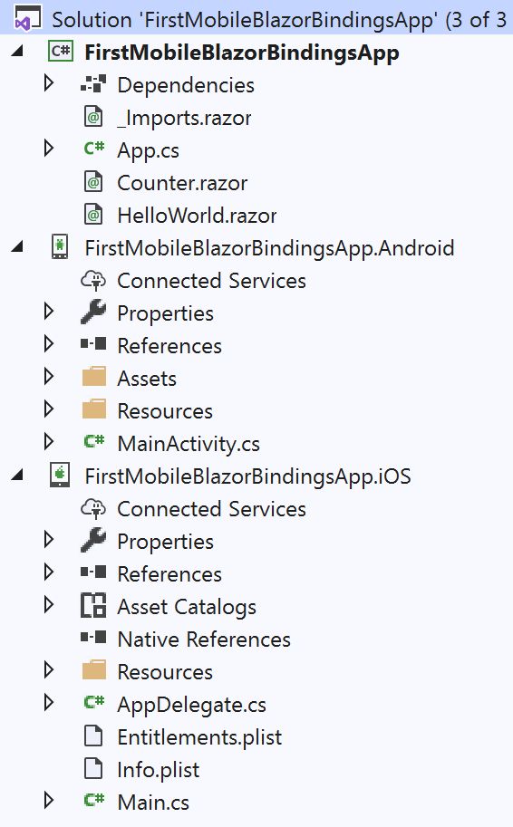
Mobile Blazor First App
Requirements (preview 2)
Install .NET Core 6.0 SDK
Add Mobile development with .NET (Xamarin.Forms) workload
Add ASP.NET and web development workload
Install the Mobile Blazor Bindings project templates
Create the app
dotnet new -i Microsoft.MobileBlazorBindings.Templates::0.5.50-preview
dotnet new mobileblazorbindings -o FirstMobileBlazorBindingsApp

Slide 34
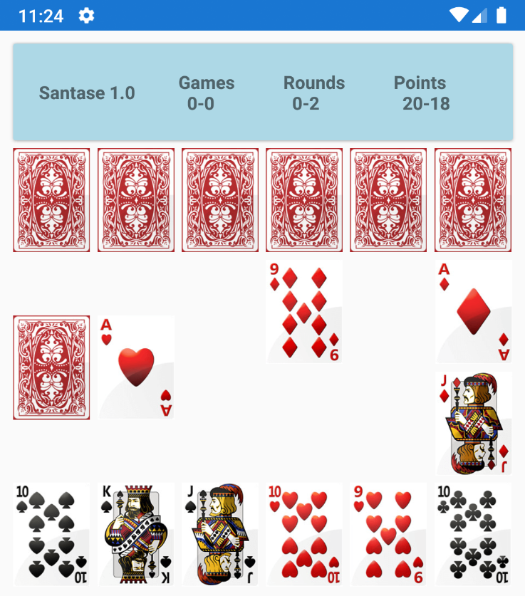
Demo: Android Santase
https://github.com/NikolayIT/SantaseGameEngine
Well-known card game Santase (66)
Full game logic implemented
Smart player implemented
.NET Standard 2.0
Native android application
Written entirely in C#, Blazor and Mobile Blazor Bindings
Not production ready (still buggy)

Slide 35
Useful Links
Official site
Documentation
Components source code
https://github.com/AdrienTorris/awesome-blazor
Components
Telerik - https://www.telerik.com/blazor-ui
Infragistics - https://www.infragistics.com/products/ignite-ui-blazor
DevExpress - https://www.devexpress.com/blazor/
Syncfusion - https://www.syncfusion.com/blazor-components
Radzen (free!) - https://blazor.radzen.com/

Slide 36

Summary
…
…
…
What is Blazor?
How is Blazor working?
WebAssembly Brief
Blazor Components
Blazor Prerequisites
Blazor Features
Blazor Demos
MusicX – an example Spotify-like app

Slide 37
Questions?
Notes:
37

Slide 38













SoftUni Diamond Partners

Slide 39


Educational Partners

Slide 40
Trainings @ Software University (SoftUni)
Software University – High-Quality Education, Profession and Job for Software Developers
softuni.bg, softuni.org
Software University Foundation
softuni.foundation
Software University @ Facebook
facebook.com/SoftwareUniversity
Software University Forums
forum.softuni.bg
Notes:
40

Slide 41

License
This course (slides, examples, demos, exercises, homework, documents, videos and other assets) is copyrighted content
Unauthorized copy, reproduction or use is illegal
© SoftUni – https://softuni.org
© Software University – https://softuni.bg
Notes:
41

